Slide 1
Software Engineering: A Practitioner’s Approach, 6/eChapter 7 Requirements Engineeringcopyright © 1996, 2001, 2005R.S. Pressman & Associates, Inc. For University Use Only May be reproduced ONLY for student use at the university level when used in conjunction with Software Engineering: A Practitioner's Approach.Any other reproduction or use is expressly prohibited.
These courseware materials are to be used in conjunction with Software Engineering: A Practitioner’s Approach, 6/e and are provided with permission by R.S. Pressman & Associates, Inc., copyright © 1996, 2001, 2005
*

Slide 2
Requirements Engineering-I
Inception—ask a set of questions that establish …
basic understanding of the problem
the people who want a solution
the nature of the solution that is desired, and
the effectiveness of preliminary communication and collaboration between the customer and the developer
Elicitation—elicit requirements from all stakeholders
Elaboration—create an analysis model that identifies data, function and behavioral requirements
Negotiation—agree on a deliverable system that is realistic for developers and customers
These courseware materials are to be used in conjunction with Software Engineering: A Practitioner’s Approach, 6/e and are provided with permission by R.S. Pressman & Associates, Inc., copyright © 1996, 2001, 2005
*

Slide 3
Requirements Engineering-II
Specification—can be any one (or more) of the following:
A written document
A set of models
A formal mathematical
A collection of user scenarios (use-cases)
A prototype
Validation—a review mechanism that looks for
errors in content or interpretation
areas where clarification may be required
missing information
inconsistencies (a major problem when large products or systems are engineered)
conflicting or unrealistic (unachievable) requirements.
Requirements management
These courseware materials are to be used in conjunction with Software Engineering: A Practitioner’s Approach, 6/e and are provided with permission by R.S. Pressman & Associates, Inc., copyright © 1996, 2001, 2005
*

Slide 4
Inception
Identify stakeholders
“who else do you think I should talk to?”
Recognize multiple points of view
Work toward collaboration
The first questions
Who is behind the request for this work?
Who will use the solution?
What will be the economic benefit of a successful solution
Is there another source for the solution that you need?
These courseware materials are to be used in conjunction with Software Engineering: A Practitioner’s Approach, 6/e and are provided with permission by R.S. Pressman & Associates, Inc., copyright © 1996, 2001, 2005
*

Slide 5
Eliciting Requirements
meetings are conducted and attended by both software engineers and customers
rules for preparation and participation are established
an agenda is suggested
a "facilitator" (can be a customer, a developer, or an outsider) controls the meeting
a "definition mechanism" (can be work sheets, flip charts, or wall stickers or an electronic bulletin board, chat room or virtual forum) is used
the goal is
to identify the problem
propose elements of the solution
negotiate different approaches, and
specify a preliminary set of solution requirements
These courseware materials are to be used in conjunction with Software Engineering: A Practitioner’s Approach, 6/e and are provided with permission by R.S. Pressman & Associates, Inc., copyright © 1996, 2001, 2005
*

Slide 6
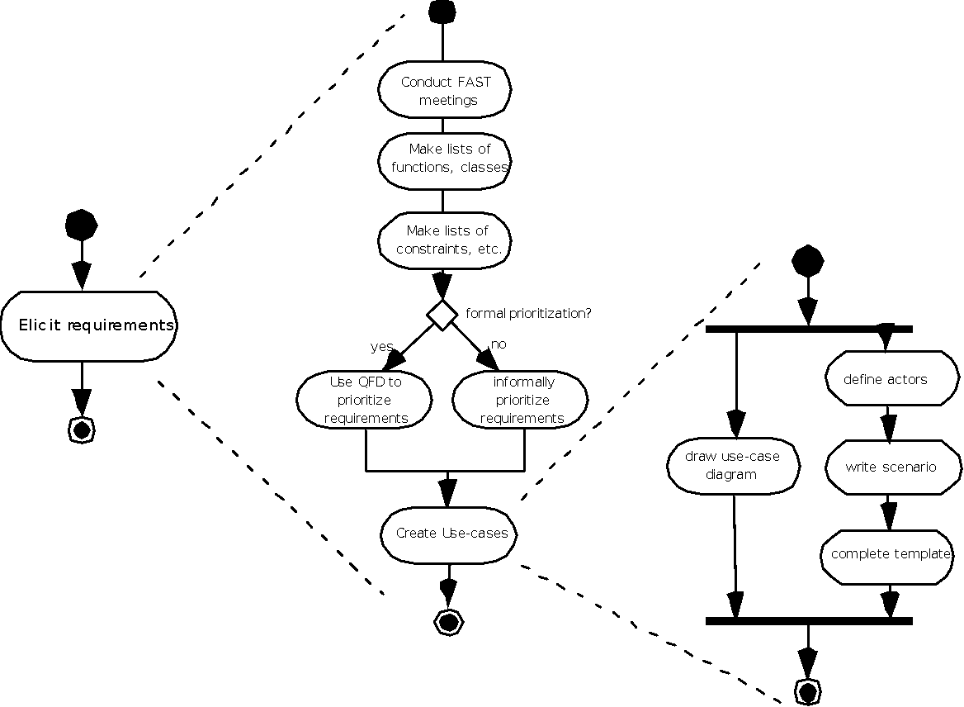
Eliciting Requirements
These courseware materials are to be used in conjunction with Software Engineering: A Practitioner’s Approach, 6/e and are provided with permission by R.S. Pressman & Associates, Inc., copyright © 1996, 2001, 2005
*

Slide 7
Quality Function Deployment
Function deployment determines the “value” (as perceived by the customer) of each function required of the system
Information deployment identifies data objects and events
Task deployment examines the behavior of the system
Value analysis determines the relative priority of requirements
These courseware materials are to be used in conjunction with Software Engineering: A Practitioner’s Approach, 6/e and are provided with permission by R.S. Pressman & Associates, Inc., copyright © 1996, 2001, 2005
*

Slide 8
Elicitation Work Products
a statement of need and feasibility.
a bounded statement of scope for the system or product.
a list of customers, users, and other stakeholders who participated in requirements elicitation
a description of the system’s technical environment.
a list of requirements (preferably organized by function) and the domain constraints that apply to each.
a set of usage scenarios that provide insight into the use of the system or product under different operating conditions.
any prototypes developed to better define requirements.
These courseware materials are to be used in conjunction with Software Engineering: A Practitioner’s Approach, 6/e and are provided with permission by R.S. Pressman & Associates, Inc., copyright © 1996, 2001, 2005
*

Slide 9
Use-Cases
A collection of user scenarios that describe the thread of usage of a system
Each scenario is described from the point-of-view of an “actor”—a person or device that interacts with the software in some way
Each scenario answers the following questions:
Who is the primary actor, the secondary actor (s)?
What are the actor’s goals?
What preconditions should exist before the story begins?
What main tasks or functions are performed by the actor?
What extensions might be considered as the story is described?
What variations in the actor’s interaction are possible?
What system information will the actor acquire, produce, or change?
Will the actor have to inform the system about changes in the external environment?
What information does the actor desire from the system?
Does the actor wish to be informed about unexpected changes?
These courseware materials are to be used in conjunction with Software Engineering: A Practitioner’s Approach, 6/e and are provided with permission by R.S. Pressman & Associates, Inc., copyright © 1996, 2001, 2005
*

Slide 10
Use-Case Diagram
These courseware materials are to be used in conjunction with Software Engineering: A Practitioner’s Approach, 6/e and are provided with permission by R.S. Pressman & Associates, Inc., copyright © 1996, 2001, 2005
*

Slide 11
Building the Analysis Model
Elements of the analysis model
Scenario-based elements
Functional—processing narratives for software functions
Use-case—descriptions of the interaction between an “actor” and the system
Class-based elements
Implied by scenarios
Behavioral elements
State diagram
Flow-oriented elements
Data flow diagram
These courseware materials are to be used in conjunction with Software Engineering: A Practitioner’s Approach, 6/e and are provided with permission by R.S. Pressman & Associates, Inc., copyright © 1996, 2001, 2005
*

Slide 12
Class Diagram
From the SafeHome system …
These courseware materials are to be used in conjunction with Software Engineering: A Practitioner’s Approach, 6/e and are provided with permission by R.S. Pressman & Associates, Inc., copyright © 1996, 2001, 2005
*

Slide 13
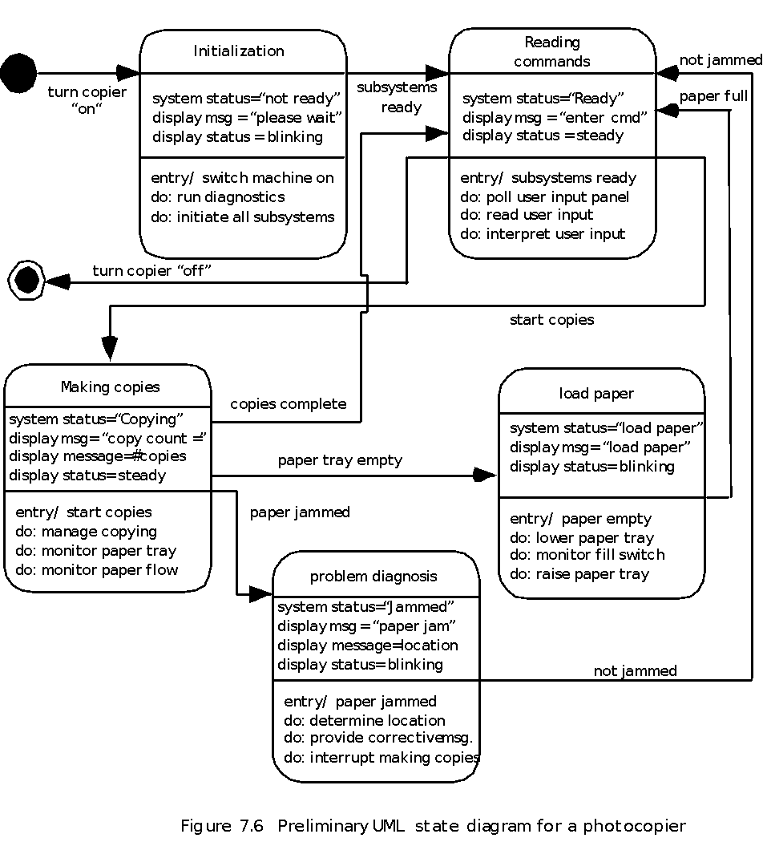
State Diagram
These courseware materials are to be used in conjunction with Software Engineering: A Practitioner’s Approach, 6/e and are provided with permission by R.S. Pressman & Associates, Inc., copyright © 1996, 2001, 2005
*

Slide 14
Analysis Patterns
Pattern name: A descriptor that captures the essence of the pattern.
Intent: Describes what the pattern accomplishes or represents
Motivation: A scenario that illustrates how the pattern can be used to address the problem.
Forces and context: A description of external issues (forces) that can affect how the pattern is used and also the external issues that will be resolved when the pattern is applied.
Solution: A description of how the pattern is applied to solve the problem with an emphasis on structural and behavioral issues.
Consequences: Addresses what happens when the pattern is applied and what trade-offs exist during its application.
Design: Discusses how the analysis pattern can be achieved through the use of known design patterns.
Known uses: Examples of uses within actual systems.
Related patterns: On e or more analysis patterns that are related to the named pattern because (1) it is commonly used with the named pattern; (2) it is structurally similar to the named pattern; (3) it is a variation of the named pattern.
These courseware materials are to be used in conjunction with Software Engineering: A Practitioner’s Approach, 6/e and are provided with permission by R.S. Pressman & Associates, Inc., copyright © 1996, 2001, 2005
*

Slide 15
Negotiating Requirements
Identify the key stakeholders
These are the people who will be involved in the negotiation
Determine each of the stakeholders “win conditions”
Win conditions are not always obvious
Negotiate
Work toward a set of requirements that lead to “win-win”
These courseware materials are to be used in conjunction with Software Engineering: A Practitioner’s Approach, 6/e and are provided with permission by R.S. Pressman & Associates, Inc., copyright © 1996, 2001, 2005
*

Slide 16
Validating Requirements-I
Is each requirement consistent with the overall objective for the system/product?
Have all requirements been specified at the proper level of abstraction? That is, do some requirements provide a level of technical detail that is inappropriate at this stage?
Is the requirement really necessary or does it represent an add-on feature that may not be essential to the objective of the system?
Is each requirement bounded and unambiguous?
Does each requirement have attribution? That is, is a source (generally, a specific individual) noted for each requirement?
Do any requirements conflict with other requirements?
These courseware materials are to be used in conjunction with Software Engineering: A Practitioner’s Approach, 6/e and are provided with permission by R.S. Pressman & Associates, Inc., copyright © 1996, 2001, 2005
*

Slide 17
Validating Requirements-II
Is each requirement achievable in the technical environment that will house the system or product?
Is each requirement testable, once implemented?
Does the requirements model properly reflect the information, function and behavior of the system to be built.
Has the requirements model been “partitioned” in a way that exposes progressively more detailed information about the system.
Have requirements patterns been used to simplify the requirements model. Have all patterns been properly validated? Are all patterns consistent with customer requirements?
These courseware materials are to be used in conjunction with Software Engineering: A Practitioner’s Approach, 6/e and are provided with permission by R.S. Pressman & Associates, Inc., copyright © 1996, 2001, 2005
*

